Slide 1

Resume Project challenge #14
Made by :
Balkrishna karankote

Slide 2
Problem statement
Lio, a leading telecommunication provider in India, is planning a strategic merger with Jotstar, one of the country’s most prominent streaming platform.
In this project our goal is to gain insights into individual platform performance, content consumption patterns, subscriber growth, Inactivity behavior, upgrade and downgrade trends which help the management make informed decisions and optimize content strategies post-merger.

Slide 3
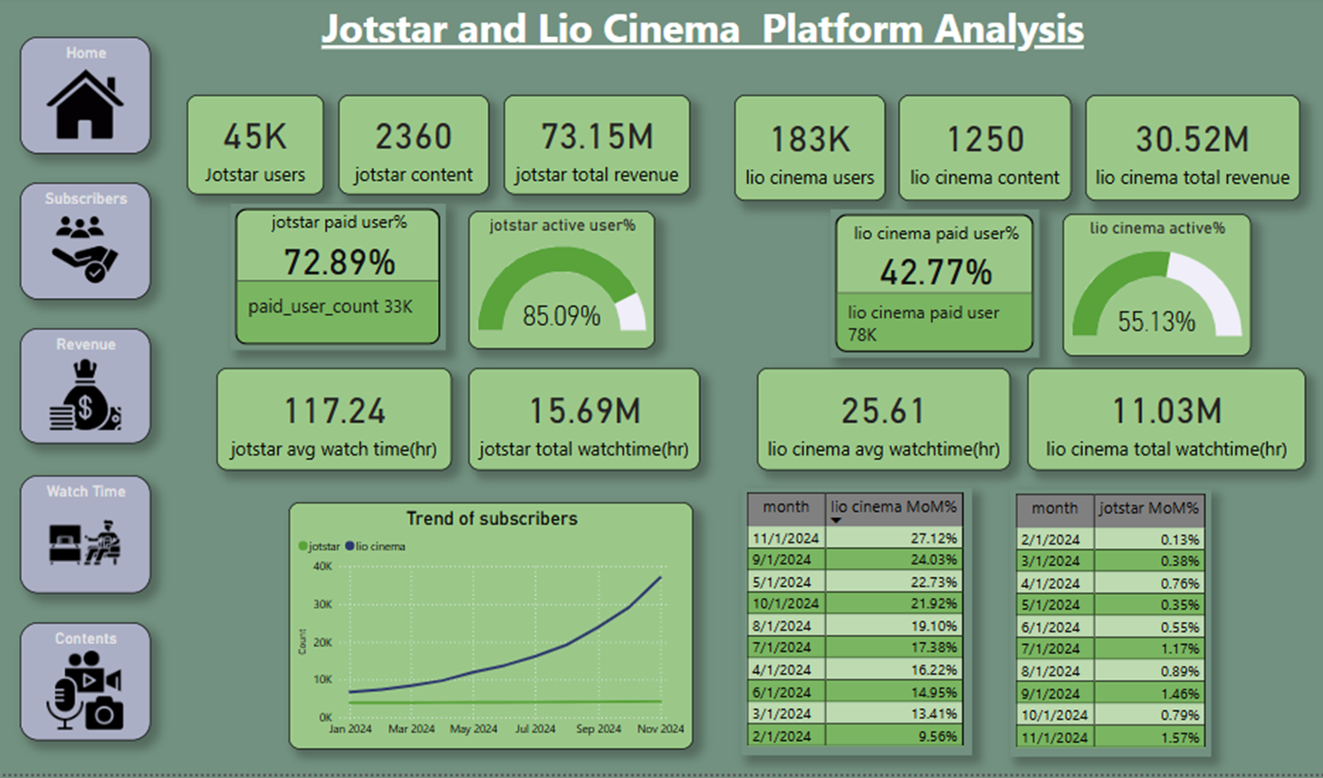

Slide 4
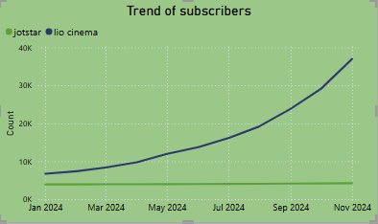
Total Users & Growth Trends
LioCinema has a subscriber base of 183K, while Jotstar has 45K subscribers.
From January to November 2024, LioCinema has experienced rapid subscriber growth, whereas Jotstar's growth has been marginal.

Slide 5
Content Library Comparison
LioCinema has a total content library of 1,250 titles, primarily consisting of movies with little to no sports content. Most of the available content is in regional languages, while English and Hindi content—the most-watched on such platforms—is limited. In terms of genre, drama is the most prominent category.
Jotstar, on the other hand, has a larger content library of 2,360 titles with a well-balanced mix of content types. It offers more content in English and Hindi compared to regional languages. Additionally, Jotstar provides content in a wider range of languages than LioCinema, with each language featuring a diverse selection of genres.

Slide 6
User Demographics
LioCinema:
Majority of users fall within the 18-24 and 25-34 age groups.
Strong user base in tier-3 and tier-2 cities.
57% of users are free subscribers.
Among paid users, most prefer the basic plan over the premium plan.
Jotstar:
Majority of users belong to the 25-34 and 34-44 age groups.
Strong user base in tier-1 and tier-2 cities.
Most users subscribe to the VIP or premium plans, with more choosing VIP over premium.
Fewer free subscribers due to the limited content available on the free plan.

Slide 7
Watch Time Analysis
Jotstar:
Average watch time: 117.24 hours
Total watch time: 15.69 million hours
Users are more engaged on Jotstar compared to LioCinema.
Age group 25-34 has the highest total watch time, while age group 18-24 has the highest average watch time.
Tier-1 users contribute the highest total watch time.
LioCinema:
Average watch time: 25.61 hours
Total watch time: 11.03 million hours
Despite having more subscribers than Jotstar, both its average watch time and total watch time are significantly lower.
Users on both platforms primarily prefer mobile devices for streaming.
Tier-3 cities have the highest number of subscribers, but tier-2 users contribute the highest total watch time.

Slide 8
Downgrade Trends
LioCinema:
Downgrade rate: 11.37% (21K users) → Higher than Jotstar
Upgrade rate: 2.26% (4K users)
Downgraded users have a higher total watch time than upgraded users.
Jotstar:
Downgrade rate: 6.15% (3K users)
Upgrade rate: 9.74% (4K users) → Higher upgrade rate than LioCinema
More users choose to upgrade rather than downgrade, indicating better retention and engagement.

Slide 9
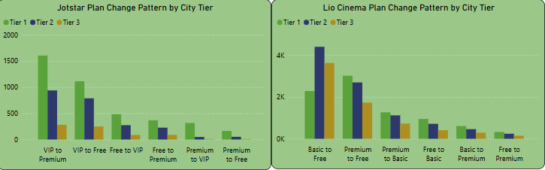
Upgrade Patterns
Jotstar: Most common upgrade pattern → VIP to Premium
LioCinema: Most common upgrade pattern → Free to Basic

Slide 10
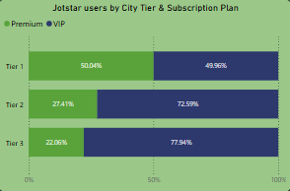
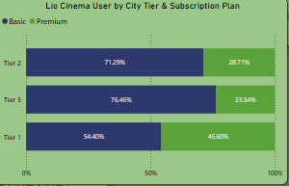
Paid Users Distribution
Paid User Percentage:
LioCinema: 42.77% (78K users)
Jotstar: 72.89% (33K users)
Premium User Distribution:
In both platforms, premium users are mostly from Tier-1 and Tier-2 cities.

Slide 11
Active vs. Inactive Users
LioCinema:
Active users: 55% (101K)
Inactive users are primarily free subscribers from Tier-3 cities.
Active users are mostly premium or basic plan subscribers.
Jotstar:
Active users: 85% (38K)
Inactive users are mostly free subscribers, with nearly 50% from Tier-1 cities.
Active users are predominantly paid subscribers.

Slide 12
Revenue analysis
Revenue Overview:
Jotstar Total Revenue: 73.15M
LioCinema Total Revenue: 30.52M
Majority of revenue comes from Tier-1 and Tier-2 cities on both platforms.
Age Group Contribution to Revenue:
Jotstar: 25-34 age group contributes 44% of the revenue.
LioCinema: 18-24 age group contributes 40% of the revenue.

Slide 13
Secondary questions:
What strategies can the merged platform implement to increase engagement among inactive users and convert them into active users?
Based on my analysis, rather than converting inactive users to active ones, the merged platform should focus on increasing its paid subscriber base. This can be achieved by:
Enhancing the quality of available content.
Offering the first episode of high-rated series or the first 10 minutes of high-rated movies for free to attract potential subscribers.
What type of brand campaigns should the merged platform launch to establish itself as the go-to OTT platform in India?
The merged platform should prioritize both quantity and quality of content, reinforced by the brand campaign: "Lio-Jotstar: Where Quantity Meets Quality."

Slide 14
How can the platform leverage partnerships with telecom companies to expand its subscriber base?
Bundling Subscription with Telecom Plans
Exclusive Data Plans
Co-Marketing & Cross-Promotion
Data & Analytics Sharing
How should the merged platform price its subscription plans to compete effectively while maintaining profitability?
Based on combination of factors:
- Content cost
- Market competition
- Consumer affordability
Local content appeal
Tiered subscription plans

Slide 15

Who should be the brand ambassador for the newly merged OTT platform (LioCinema-Jotstar) to effectively represent its identity and attract a diverse audience?

Slide 16


